Slide 1
Icertis Intake From
"Cheat Sheet"
This document serves as a cheat sheet as you populate fields that will display on your contract draft. Most of the fields present on this cheat sheet appear when you create a MSA or SOW.
Corresponding Documents:
Contracts Glossary
Creating a SOW
Creating a Master Agreement

Slide 2
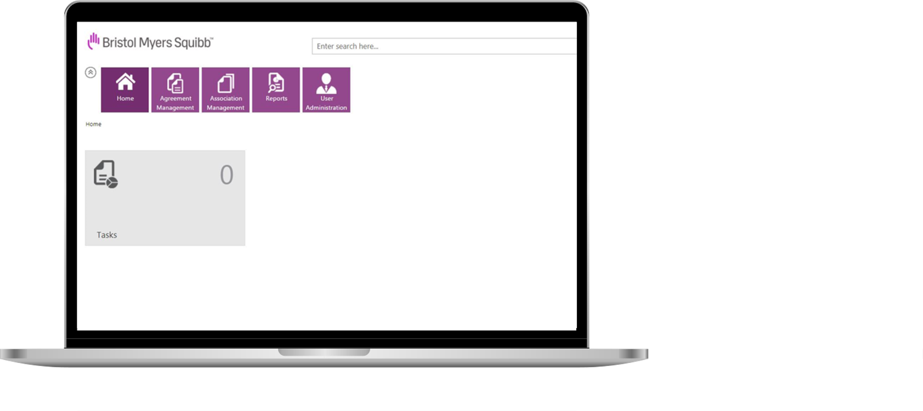
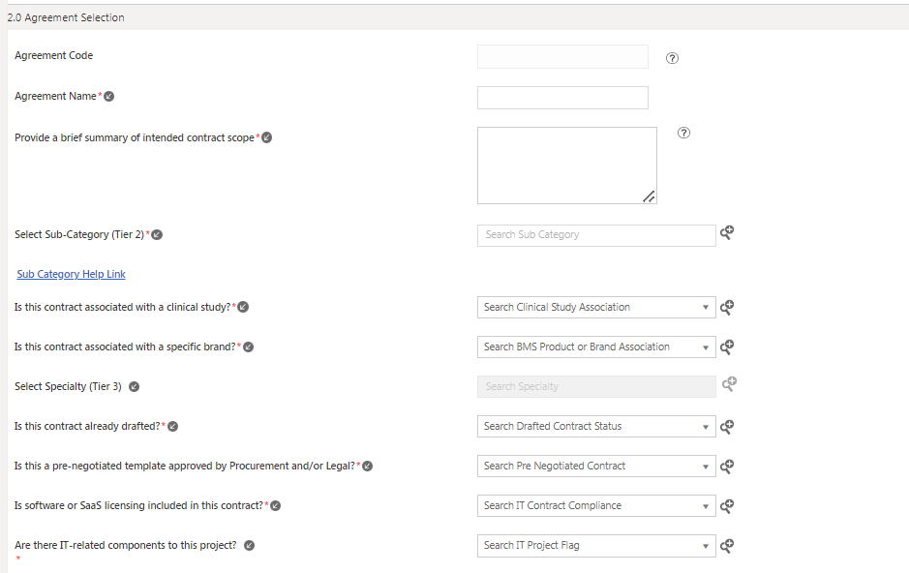
2.0 Agreement Selection (Part 1)
Icertis Field | Helpful Information
Icertis Agreement Code | Autogenerated field
Agreement Name | Purchasing Agreement or Confidentiality Agreement
Brief Description of Purpose | State the reason for the agreement
Select Sub-Category (Tier 2) | Need more information on Sub-Category? Check out more information the Buyer Portal
Is this contract associated with a clinical study? | If “Yes” is selected, please enter the Study Protocol ID
Is this contract associated with a specific brand? | If “Yes” is selected, please select the Brand
3

Slide 3
2.0 Agreement Selection (Part 2)
Icertis Field | Helpful Information
Select Specialty (Tier 3) | Need more information on Specialty? Check out more information the Buyer Portal
Is this contract already drafted? | If “Yes” is select, the facilitator already has a contract draft and will not be using the template in Icertis.
Is this a pre-negotiated template approved by Procurement and/or Legal? | If “Yes” is selected, the template should be uploaded into the Associated Documents section of the agreement workspace. Please list any instructions (including permitted uses, use restrictions, etc.) for the SOW form in the Document Description field.
Is software or SaaS licensing included in this contract? | If “Yes” is selected, an additional IT Reviewer will be added to the agreement workflow.
Are there IT-related components to this project? | If “Yes” is selected, an additional IT Reviewer will be added to the agreement workflow.
3

Slide 4
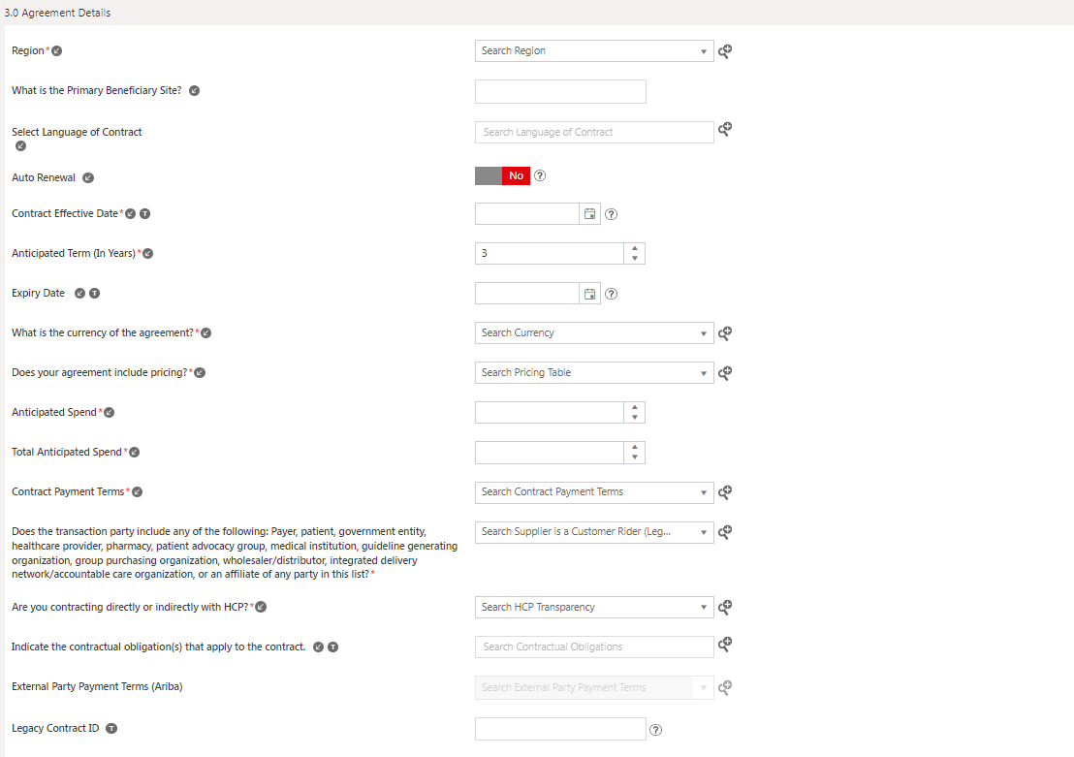
3.0 Agreement Details (Part 1)
Icertis Field | Helpful Information
Region | For Wave 1 of Icertis Implementation, please select United States or Global
What is the Primary Beneficiary Site? | Please select the location where the services will be completed
Select Language of Contract | For Wave 1 of Icertis Implementation, please select English
Auto Renewal? | This is defaulted to Auto Renewal
Contract Effective Date | Today or when you think the contract will be effective
Expected Term Life | Autogenerated field
5

Slide 5
3.0 Agreement Details (Part 2)
Icertis Field | Helpful Information
Expiry Date | When the contract will expire
What is the currency of the agreement? | To find currency for the United States, search “US Dollar”
Does your agreement include pricing? | If “Yes” is selected, please include the Pricing Table in the Supporting Documents.
Anticipated Spend | Foreseeable spend on the agreement
Total Anticipated Spend | Cumulative value of all amendments pertaining to the agreement
Contract Payment Terms | Autopopulated, depending on Effective Date
5

Slide 6
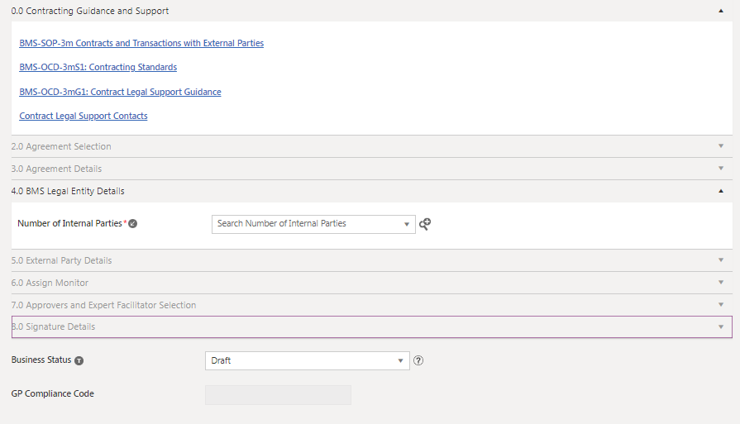
4.0 BMS Legal Entity Details
Icertis Field | Helpful Information
Number of Internal Parties | You can select either 1 or 2
5

Slide 7
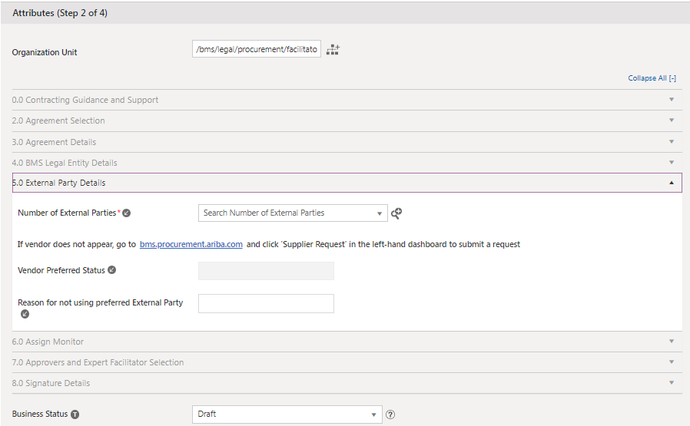
5.0 External Party Details
Icertis Field | Helpful Information
Number of External Parties | You can only select 1, 2, or 3 external parties.
Vendor Preferred Status | This is an autopopulated field. All preferred suppliers can be found in the Buyer Portal.
Reason for not using preferred External Party | If a non-preferred supplier is selected, please indicate the reason for the selection.
Legacy Contract ID | The Contract ID # for Contracts migrated from Ariba.
5

Slide 8
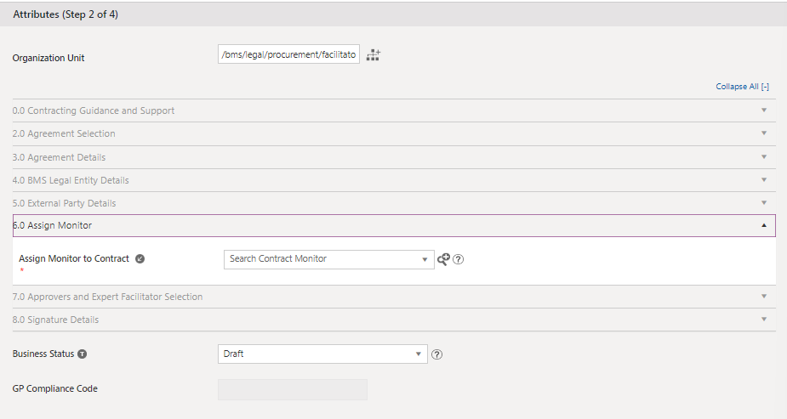
6.0 Assign Monitor
Icertis Field | Helpful Information
Assign Monitor to Contract | The individual is the BMS employee or Authorized Person who is the primary point of contact for the Transaction, and monitors the performance of the Written Contract to help ensure that the rights and obligations of the signed Written Contract are met.
5

Slide 9
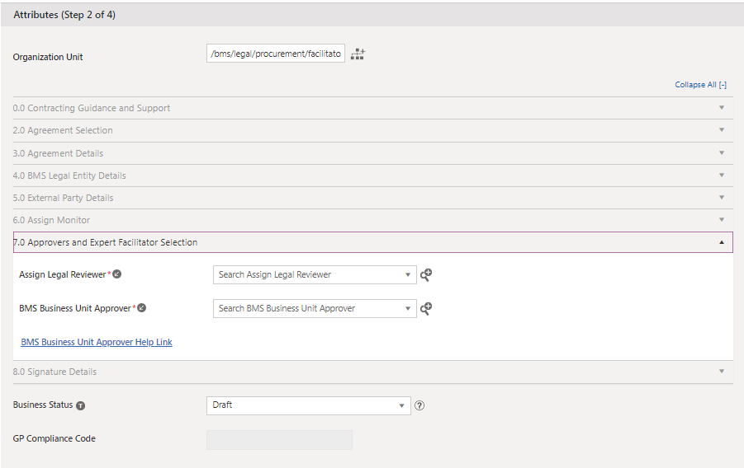
7.0 Approvers and Expert Facilitator Selection
Icertis Field | Helpful Information
Assign Legal Reviewer | For Wave 1 Icertis Go-Live, Legal Review is a Mandatory field when creating a contract. Icertis will only route the contract for Legal Review when it is necessary, dependent on the contract metadata inputs.
BMS Business Unit Approver | An accountable employee with sufficient Approval Authority under BMS _CD 021b to approve the Contract, Change Request and /or Amendment. Assigns Monitor when applicable
Execution Date | User- selected
Signature Sequence | Internal First (BMS Signer) or External First (Supplier Signer)
Signature Type | When will the contract be executed (Note: this field will be updated upon contract signature.)
Adobe Add Signature Tags | Auto-selected to “No” Note: Switch to “Yes” always to give facilitator option to place Signature Tags
5

Slide 10
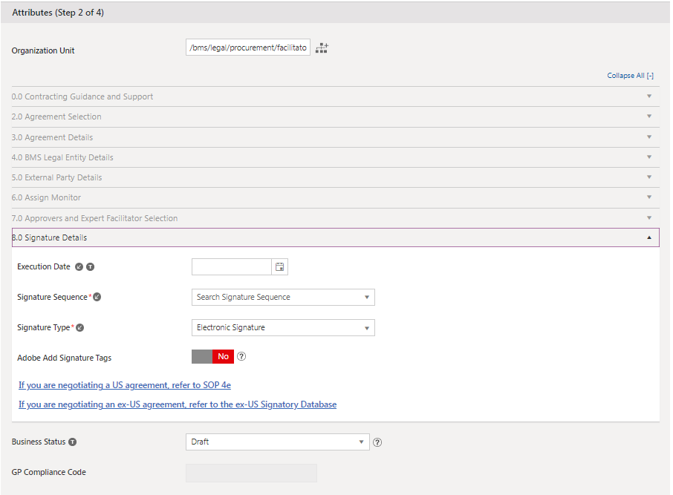
8.0 Signature Details
Icertis Field | Helpful Information
Execution Date | Input Date
Signature Sequence | Chose the primary sequence
Signature Type | Either manual or electronic
Adobe Add Signature Tags | Yes or No
5

Slide 11
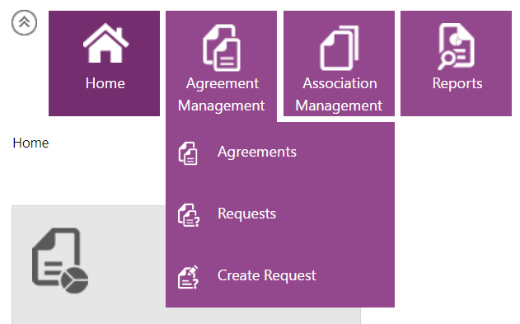
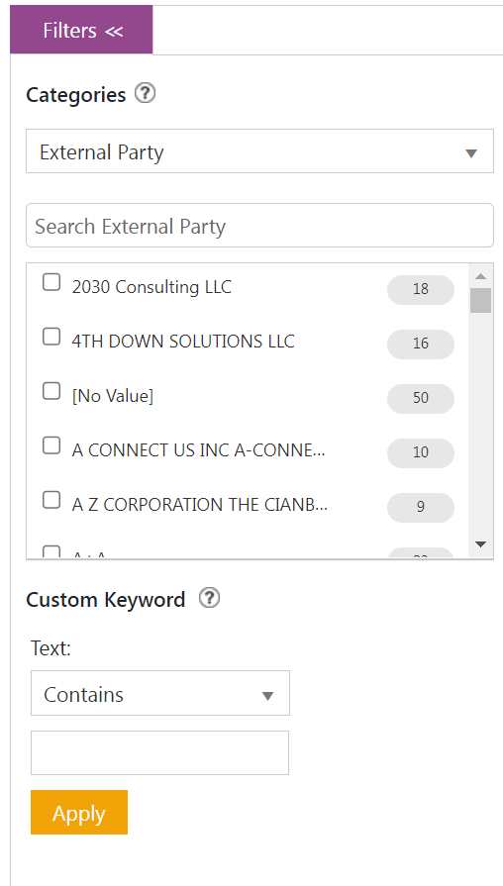
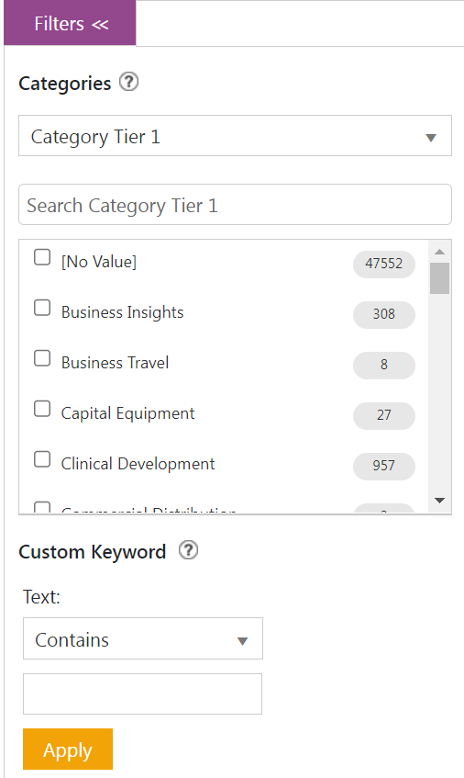
Contract Searches
Useful Searches:
How to Navigate to Search:
Agreement Management -> Agreements
Filter > Categories > Select External Party
Filter > Categories > Select Category Tier 1
12

Slide 12
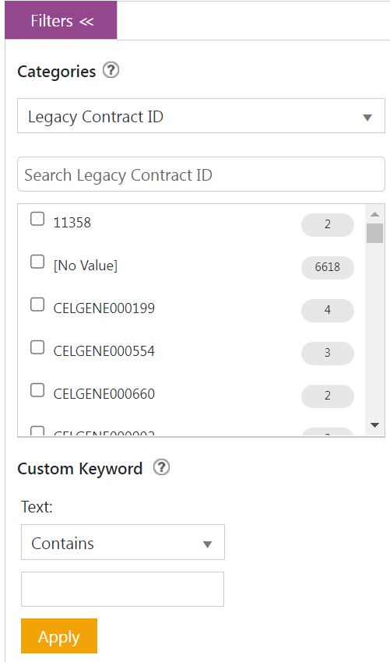
Contract Searches
Useful Searches:
Filter > Categories > Select Legacy ID (Ariba CW)
Filter > Categories > Select Agreement Code (Icertis Code)
12

